Slide 1
Introduction to Probability and Statistics
Twelfth Edition
Robert J. Beaver • Barbara M. Beaver • William Mendenhall
Presentation designed and written by:
Barbara M. Beaver

Slide 2
Introduction to Probability and Statistics
Twelfth Edition
Chapter 2
Describing Data
with Numerical Measures
Some graphic screen captures from Seeing Statistics ®
Some images © 2001-(current year) www.arttoday.com

Slide 3
Describing Data with Numerical Measures
Graphical methods may not always be sufficient for describing data.
Numerical measures can be created for both populations and samples.
  A parameter is a numerical descriptive measure calculated for a population.
  A statistic is a numerical descriptive measure calculated for a sample.

Slide 4
Measures of Center
A measure along the horizontal axis of the data distribution that locates the center of the distribution.

Slide 5
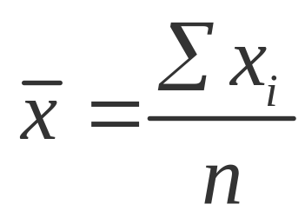
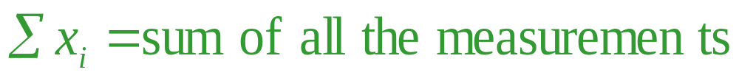
Arithmetic Mean or Average
The mean of a set of measurements is the sum of the measurements divided by the total number of measurements.
where n = number of measurements

Slide 6
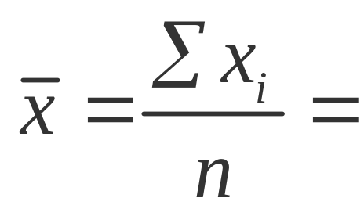
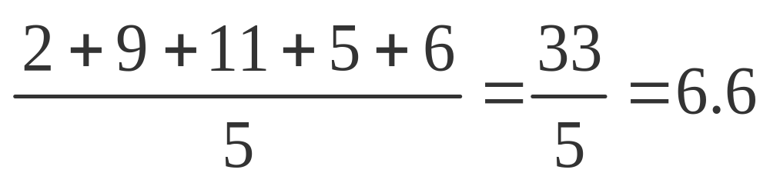
Example
The set: 2, 9, 1, 5, 6
If we were able to enumerate the whole population, the population mean would be called μ (the Greek letter “mu”).

Slide 7
Median
The median of a set of measurements is the middle measurement when the measurements are ranked from smallest to largest.
The position of the median is
.5(n + 1)
  once the measurements have been ordered.

Slide 8
Example
The set: 2, 4, 9, 8, 6, 5, 3 n = 7
Sort: 2, 3, 4, 5, 6, 8, 9
Position: .5(n + 1) = .5(7 + 1) = 4th
Median = 4th largest measurement
The set: 2, 4, 9, 8, 6, 5 n = 6
Sort: 2, 4, 5, 6, 8, 9
Position: .5(n + 1) = .5(6 + 1) = 3.5th
Median = (5 + 6)/2 = 5.5 — average of the 3rd and 4th measurements

Slide 9
Mode
The mode is the measurement which occurs most frequently.
The set: 2, 4, 9, 8, 8, 5, 3
  The mode is 8, which occurs twice
The set: 2, 2, 9, 8, 8, 5, 3
  There are two modes—8 and 2 (bimodal)
The set: 2, 4, 9, 8, 5, 3
  There is no mode (each value is unique).

Slide 10
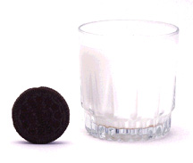
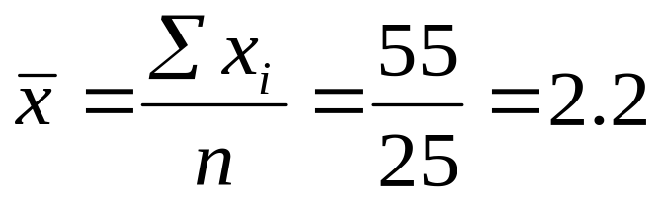
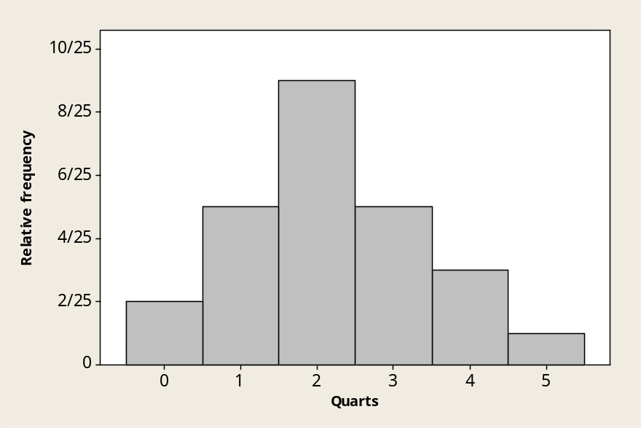


Example
The number of quarts of milk purchased by 25 households:
0 0 1 1 1 1 1 2 2 2 2 2 2 2 2 2 3 3 3 3 3 4 4 4 5
Mean?
Median?
Mode? (Highest peak)

Slide 11
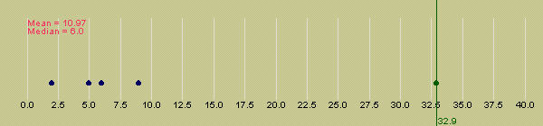
Extreme Values
The mean is more easily affected by extremely large or small values than the median.
MY
APPLET
The median is often used as a measure of center when the distribution is skewed.

Slide 12
Extreme Values
Symmetric: Mean = Median
Skewed right: Mean > Median
Skewed left: Mean < Median

Slide 13
Measures of Variability
A measure along the horizontal axis of the data distribution that describes the spread of the distribution from the center.

Slide 14

The Range
The range, R, of a set of n measurements is the difference between the largest and smallest measurements.
Example: A botanist records the number of petals on 5 flowers:
5, 12, 6, 8, 14
The range is
R = 14 – 5 = 9.
Quick and easy, but only uses 2 of the 5 measurements.

Slide 15

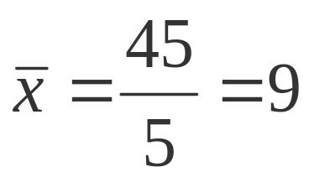
The Variance
The variance is measure of variability that uses all the measurements. It measures the average deviation of the measurements about their mean.
Flower petals: 5, 12, 6, 8, 14
4 6 8 10 12 14

Slide 16
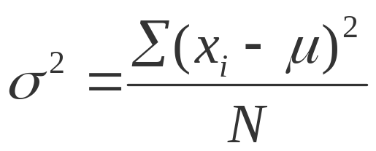
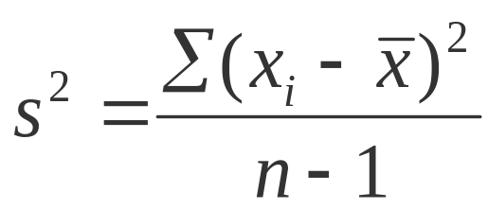
The Variance
The variance of a population of N measurements is the average of the squared deviations of the measurements about their mean μ.
The variance of a sample of n measurements is the sum of the squared deviations of the measurements about their mean, divided by (n – 1).

Slide 17
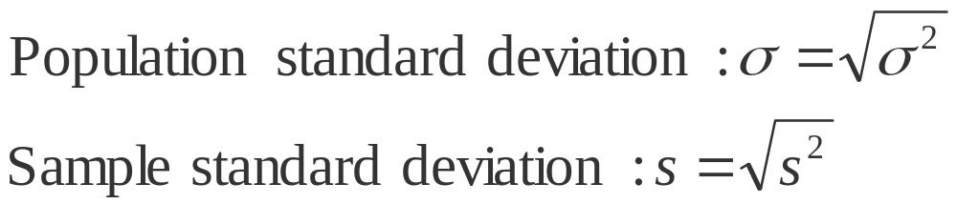
The Standard Deviation
In calculating the variance, we squared all of the deviations, and in doing so changed the scale of the measurements.
To return this measure of variability to the original units of measure, we calculate the standard deviation, the positive square root of the variance.

Slide 18
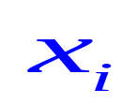

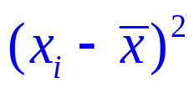
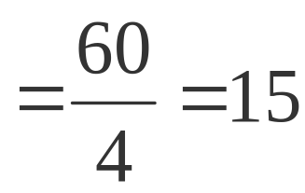
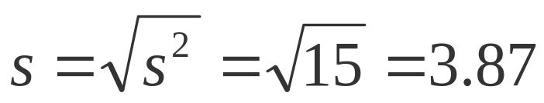
Two Ways to Calculate the Sample Variance
Use the Definition Formula:
 | 5 | -4 | 16
 | 12 | 3 | 9
 | 6 | -3 | 9
 | 8 | -1 | 1
 | 14 | 5 | 25
Sum | 45 | 0 | 60

Slide 19


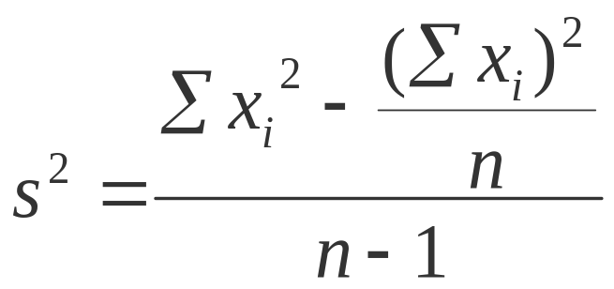
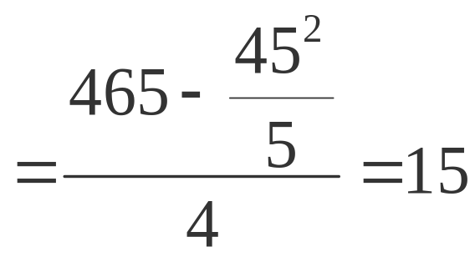
Two Ways to Calculate the Sample Variance
Use the Calculational Formula:
 | 5 | 25
 | 12 | 144
 | 6 | 36
 | 8 | 64
 | 14 | 196
Sum | 45 | 465

Slide 20
Some Notes
MY
APPLET
The value of s is ALWAYS positive.
The larger the value of s² or s, the larger the variability of the data set.
Why divide by n –1?
  The sample standard deviation s is often used to estimate the population standard deviation σ. Dividing by n –1 gives us a better estimate of σ.

Slide 21

Using Measures of Center and Spread: Tchebysheff’s Theorem
Given a number k greater than or equal to 1 and a set of n measurements, at least 1-(1/k²) of the measurement will lie within k standard deviations of the mean.
Can be used for either samples ( and s) or for a population (μ and σ).
Important results:
  If k = 2, at least 1 – 1/2² = 3/4 of the measurements are within 2 standard deviations of the mean.
  If k = 3, at least 1 – 1/3² = 8/9 of the measurements are within 3 standard deviations of the mean.

Slide 22
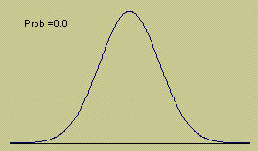
Using Measures of
Center and Spread:
The Empirical Rule
Given a distribution of measurements
that is approximately mound-shaped:
The interval μ ± σ contains approximately 68% of the measurements.
The interval μ ± 2σ contains approximately 95% of the measurements.
The interval μ ± 3σ contains approximately 99.7% of the measurements.

Slide 23

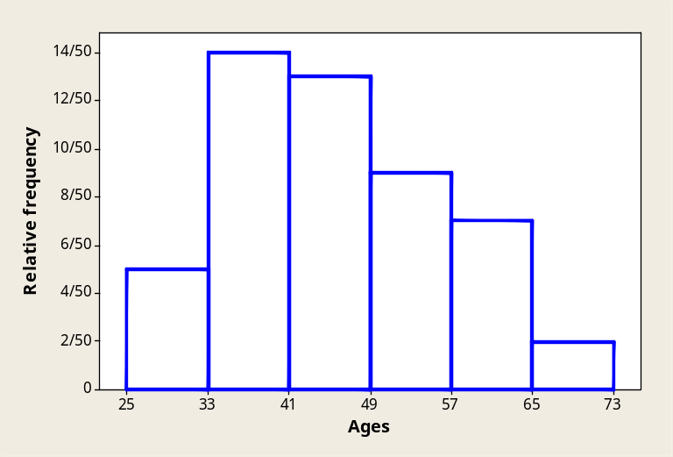
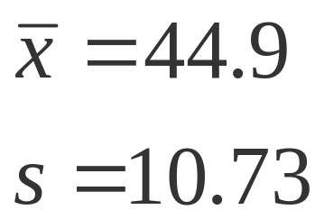
Example
The ages of 50 tenured faculty at a
state university.
34 48 70 63 52 52 35 50 37 43 53 43 52 44
42 31 36 48 43 26 58 62 49 34 48 53 39 45
34 59 34 66 40 59 36 41 35 36 62 34 38 28
43 50 30 43 32 44 58 53
Shape?
Skewed right

Slide 24

k | ±ks | Interval | Proportion in Interval | Tchebysheff | Empirical Rule
1 | 44.9 ±10.73 | 34.17 to 55.63 | 31/50 (.62) | At least 0 | ≈ .68
2 | 44.9 ±21.46 | 23.44 to 66.36 | 49/50 (.98) | At least .75 | ≈ .95
3 | 44.9 ±32.19 | 12.71 to 77.09 | 50/50 (1.00) | At least .89 | ≈ .997
Yes. Tchebysheff’s Theorem must be true for any data set.
Do the actual proportions in the three intervals agree with those given by Tchebysheff’s Theorem?
Do they agree with the Empirical Rule?
Why or why not?
No. Not very well.
The data distribution is not very mound-shaped, but skewed right.

Slide 25
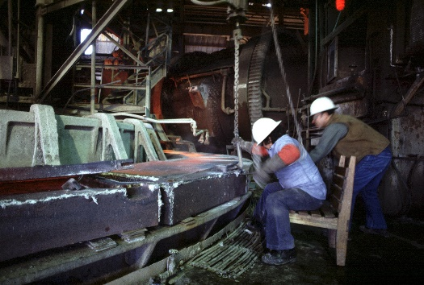
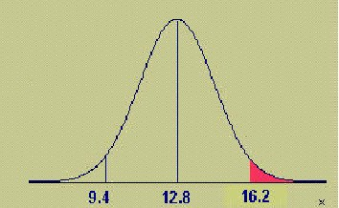
Example
The length of time for a worker to
complete a specified operation averages
12.8 minutes with a standard deviation of 1.7 minutes. If the distribution of times is approximately mound-shaped, what proportion of workers will take longer than 16.2 minutes to complete the task?
95% between 9.4 and 16.2
47.5% between 12.8 and 16.2
.475
.475
.025
(50-47.5)% = 2.5% above 16.2

Slide 26
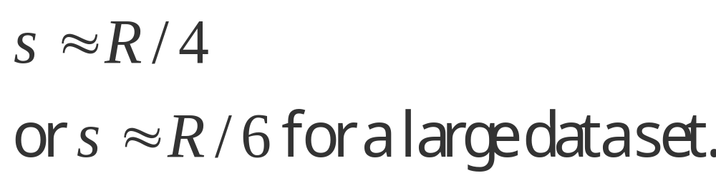
Approximating s
From Tchebysheff’s Theorem and the Empirical Rule, we know that
  R ≈ 4-6 s
To approximate the standard deviation of a set of measurements, we can use:

Slide 27
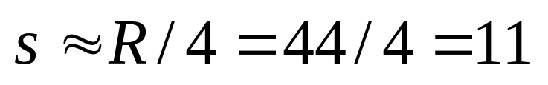
Approximating s
The ages of 50 tenured faculty at a
state university.
34 48 70 63 52 52 35 50 37 43 53 43 52 44
42 31 36 48 43 26 58 62 49 34 48 53 39 45
34 59 34 66 40 59 36 41 35 36 62 34 38 28
43 50 30 43 32 44 58 53
R = 70 – 26 = 44
Actual s = 10.73

Slide 28
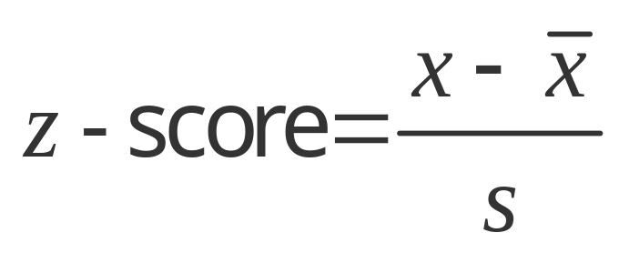


Measures of Relative Standing
Where does one particular measurement stand in relation to the other measurements in the data set?
How many standard deviations away from the mean does the measurement lie? This is measured by the z-score.
Suppose s = 2.
s
4
s
s
x = 9 lies z =2 std dev from the mean.

Slide 29
z-Scores
From Tchebysheff’s Theorem and the Empirical Rule
  At least 3/4 and more likely 95% of measurements lie within 2 standard deviations of the mean.
  At least 8/9 and more likely 99.7% of measurements lie within 3 standard deviations of the mean.
z-scores between –2 and 2 are not unusual. z-scores should not be more than 3 in absolute value. z-scores larger than 3 in absolute value would indicate a possible outlier.
Outlier
Not unusual
Outlier
z
-3 -2 -1 0 1 2 3
Somewhat unusual

Slide 30
Measures of Relative Standing
How many measurements lie below the measurement of interest? This is measured by the p^{th} percentile.
p %
(100-p) %
x
p-th percentile

Slide 31
Examples
90% of all men (16 and older) earn more than $319 per week.
BUREAU OF LABOR STATISTICS
10%
90%
$319 is the 10th percentile.
$319
50th Percentile
25th Percentile
75th Percentile
≡ Median
≡ Lower Quartile (Q₁)
≡ Upper Quartile (Q₃)

Slide 32
Quartiles and the IQR
The lower quartile (Q₁) is the value of x which is larger than 25% and less than 75% of the ordered measurements.
The upper quartile (Q₃) is the value of x which is larger than 75% and less than 25% of the ordered measurements.
The range of the “middle 50%” of the measurements is the interquartile range,
IQR = Q₃ – Q₁

Slide 33
Calculating Sample Quartiles
The lower and upper quartiles (Q₁ and Q₃), can be calculated as follows:
The position of Q₁ is
.25(n + 1)
The position of Q₃ is
.75(n + 1)
once the measurements have been ordered. If the positions are not integers, find the quartiles by interpolation.

Slide 34
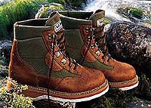
Example
The prices ($) of 18 brands of walking shoes:
60 65 65 65 68 68 70 70
70 70 70 70 74 75 75 90 95
Position of Q₁ = .25(18 + 1) = 4.75
Position of Q₃ = .75(18 + 1) = 14.25
Q₁is 3/4 of the way between the 4th and 5th ordered measurements, or
  Q₁ = 65 + .75(65 - 65) = 65.

Slide 35
Example
The prices ($) of 18 brands of walking shoes:
60 65 65 65 68 68 70 70
70 70 70 70 74 75 75 90 95
Position of Q₁ = .25(18 + 1) = 4.75
Position of Q₃ = .75(18 + 1) = 14.25
Q₃ is 1/4 of the way between the 14th and 15th ordered measurements, or
  Q₃ = 75 + .25(75 - 74) = 75.25
  and
  IQR = Q₃ – Q₁ = 75.25 - 65 = 10.25

Slide 36
Using Measures of Center and Spread: The Box Plot
The Five-Number Summary:
Min Q₁ Median Q₃ Max
Divides the data into 4 sets containing an equal number of measurements.
A quick summary of the data distribution.
Use to form a box plot to describe the shape of the distribution and to detect outliers.

Slide 37
Constructing a Box Plot
Calculate Q₁, the median, Q₃ and IQR.
Draw a horizontal line to represent the scale of measurement.
Draw a box using Q₁, the median, Q₃.
Q₁
m
Q₃

Slide 38
Constructing a Box Plot
Isolate outliers by calculating
  Lower fence: Q₁-1.5 IQR
  Upper fence: Q₃+1.5 IQR
Measurements beyond the upper or lower fence is are outliers and are marked (*).
*
Q₁
m
Q₃

Slide 39
Constructing a Box Plot
Draw “whiskers” connecting the largest and smallest measurements that are NOT outliers to the box.
*
Q₁
m
Q₃

Slide 40
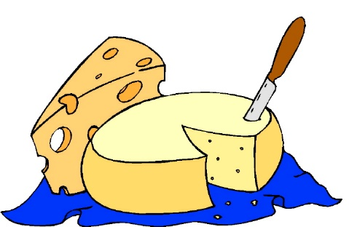
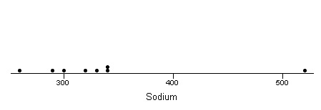
Example
Amt of sodium in 8 brands of cheese:
260 290 300 320 330 340 340 520
Q₁ = 292.5
m = 325
Q₃ = 340
MY
APPLET
m
Q₁
Q₃

Slide 41
Example
IQR = 340-292.5 = 47.5
Lower fence = 292.5-1.5(47.5) = 221.25
Upper fence = 340 + 1.5(47.5) = 411.25
MY
APPLET
Outlier: x = 520
*
m
Q₁
Q₃

Slide 42
Interpreting Box Plots
Median line in center of box and whiskers of equal length—symmetric distribution
Median line left of center and long right whisker—skewed right
Median line right of center and long left whisker—skewed left

Slide 43
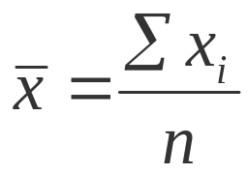
Key Concepts
I. Measures of Center
1. Arithmetic mean (mean) or average
a. Population: μ
b. Sample of size n:
2. Median: position of the median = .5(n +1)
3. Mode
4. The median may preferred to the mean if the data are
highly skewed.
II. Measures of Variability
1. Range: R = largest − smallest

Slide 44
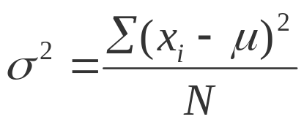
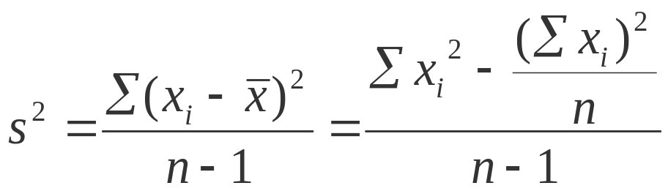
Key Concepts
2. Variance
a. Population of N measurements:
b. Sample of n measurements:
3. Standard deviation
4. A rough approximation for s can be calculated as s ≈ R / 4.
The divisor can be adjusted depending on the sample size.

Slide 45
Key Concepts
III. Tchebysheff’s Theorem and the Empirical Rule
1. Use Tchebysheff’s Theorem for any data set, regardless of
its shape or size.
a. At least 1-(1/k ² ) of the measurements lie within k
standard deviation of the mean.
b. This is only a lower bound; there may be more
measurements in the interval.
2. The Empirical Rule can be used only for relatively mound-
shaped data sets.
  Approximately 68%, 95%, and 99.7% of the measurements are within one, two, and three standard deviations of the mean, respectively.

Slide 46
Key Concepts
IV. Measures of Relative Standing
1. Sample z-score:
2. pth percentile; p% of the measurements are smaller, and
(100 − p)% are larger.
3. Lower quartile, Q ₁; position of Q ₁ = .25(n +1)
4. Upper quartile, Q ₃ ; position of Q ₃ = .75(n +1)
5. Interquartile range: IQR = Q ₃ − Q ₁
V. Box Plots
1. Box plots are used for detecting outliers and shapes of
distributions.
2. Q ₁ and Q ₃ form the ends of the box. The median line is in
the interior of the box.

Slide 47
Key Concepts
3. Upper and lower fences are used to find outliers.
a. Lower fence: Q ₁ − 1.5(IQR)
b. Outer fences: Q ₃ + 1.5(IQR)
4. Whiskers are connected to the smallest and largest measurements that are not outliers.
5. Skewed distributions usually have a long whisker in the direction of the skewness, and the median line is drawn away from the direction of the skewness.

